Slide 1


Transportation Safety Board of Canada (TSB)
Air Transportation Occurences
Final Project : Ifeoluwa Badmus

Slide 2
Content
Transportation Safety Board of Canada
Vision
Strategic Objectives
Business Needs
Balanced Score Card
Solution
Reports and Dashboards

Slide 3



Vision
A world-leading investigation organization that influences change to advance transportation safety.
Our strategic objectives
Strengthen the impact of our investigations
Foster an inclusive, diversified and respectful workplace
Employ a knowledgeable and highly skilled workforce
Leverage data to drive our choices and decisions
Be digital by default
Communicate with impact

Slide 4

Current State / Problem Definition
TSB has taken key actions to reduce the likelihood of flight occurrences and improve air safety in Canada
Monthly and annual publications containing graphs and tables
The department has continued to receive feedbacks on how difficult it has been to navigate these reports.
The need for a more dynamic reporting system that helps track key air safety performance indicators have therefore been identified

Slide 5

Business Needs
Determine impact of the agency’s actions on flight occurrences
Determine whether the agency’s actions are making travelers safer during their trips in Canada
Determine how the Covid-19 pandemic has influenced the status quo
Determine which operators are reporting the highest occurrences and injuries
Make policies that help improve safety practices throughout all flight phases

Slide 6
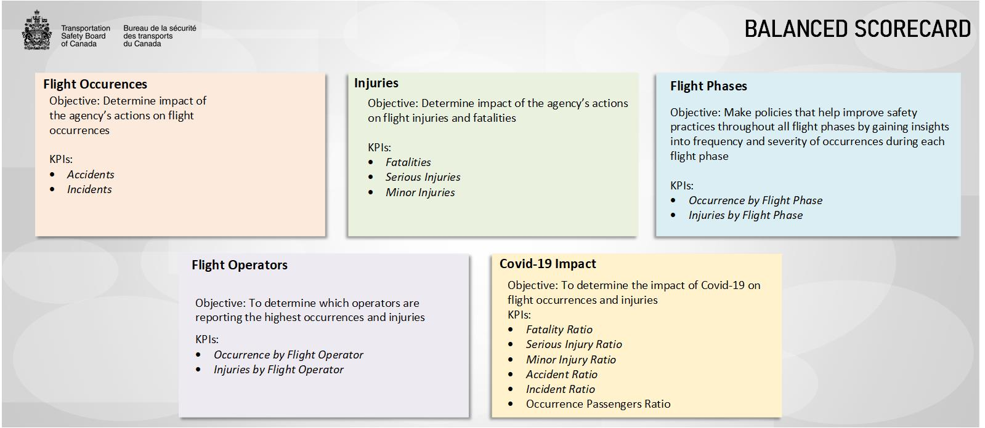

Slide 7
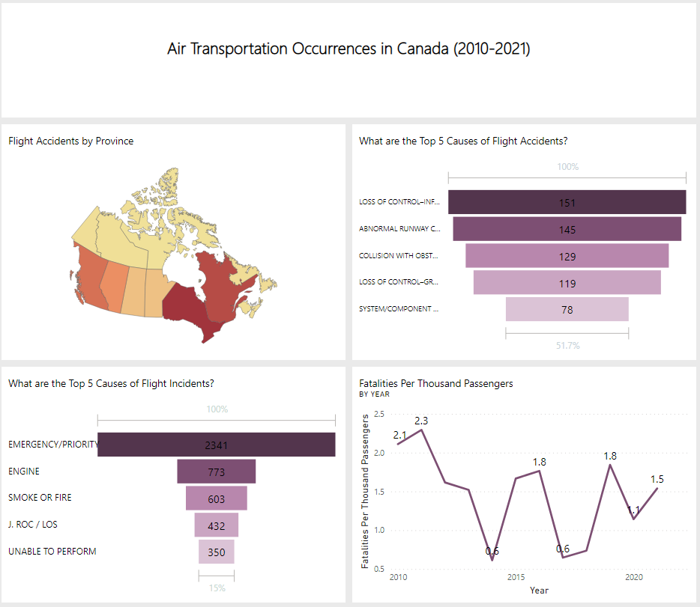
Solution
Dashboard
Notes:
This page shows a dashboard of tiles from different report pages in Power BI Service

Slide 8
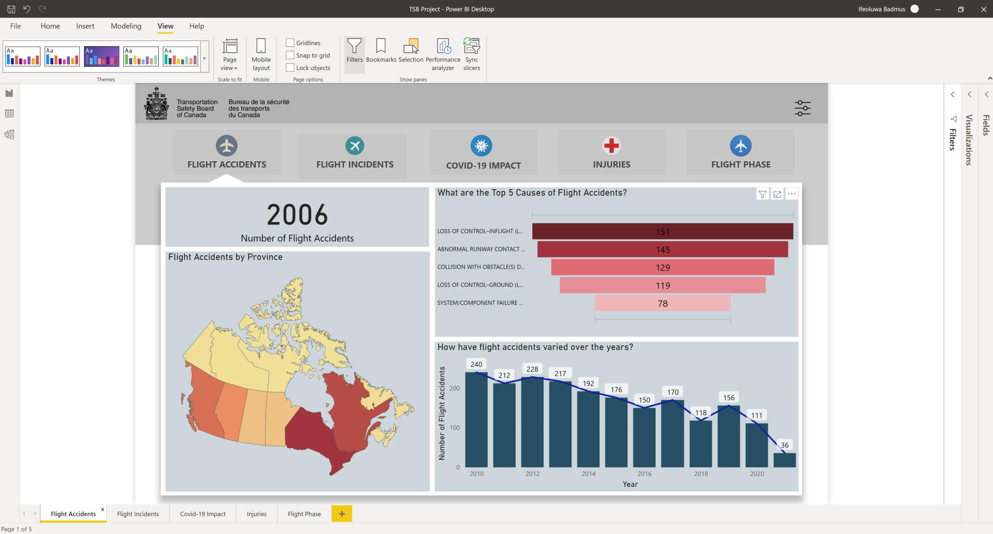
Solution
Reports
Notes:
A flight Accident report page showing Total number of Flight Accidents in Canada since 2010, top causes, trend over the years and a heat map of the accidents by province

Slide 9
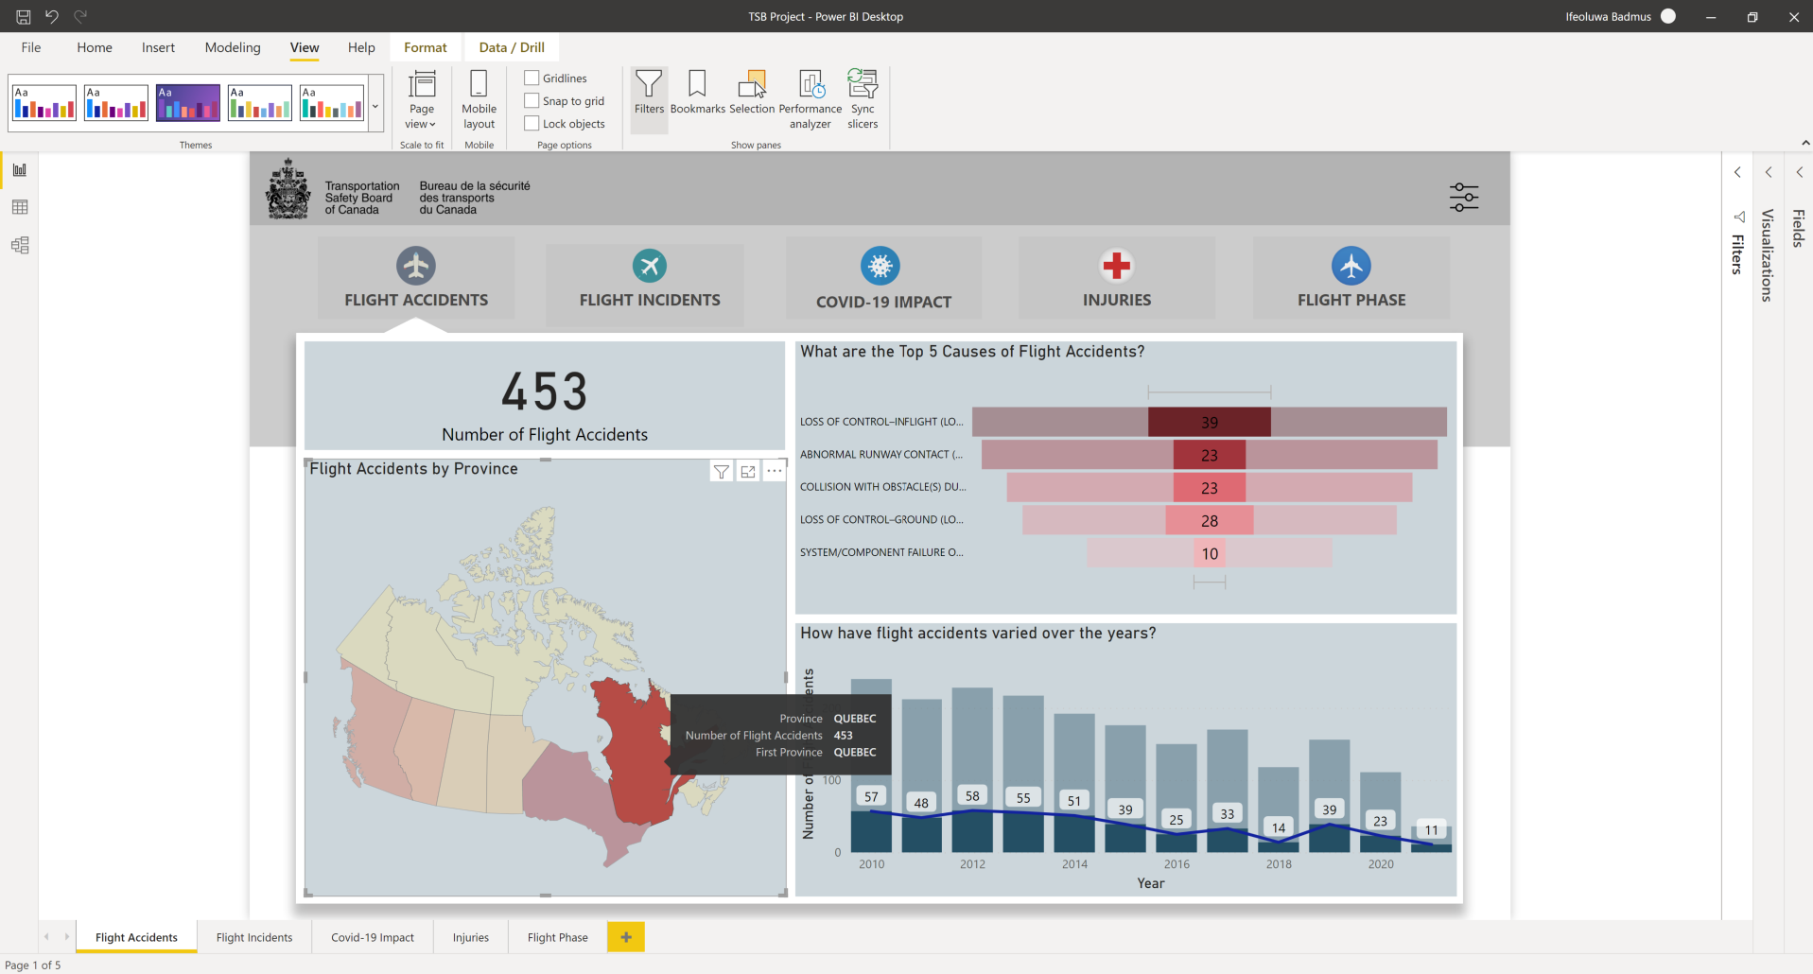
Solution
Reports
Notes:
A drill down by province of Quebec.

Slide 10
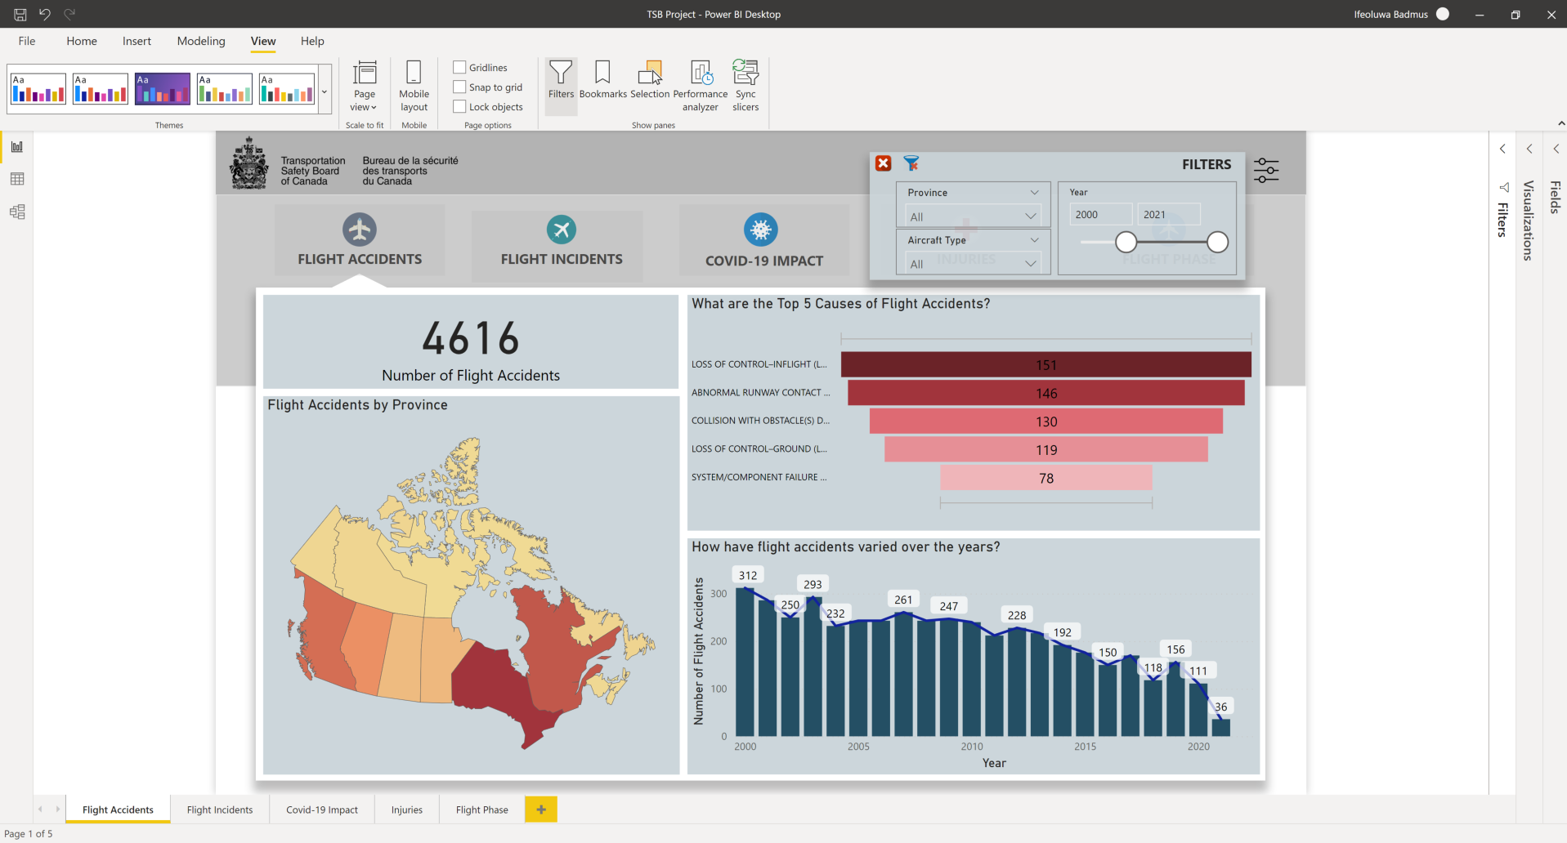
Solution
Reports
Notes:
Note the filter and how I have adjusted it to show accidents from year 2000.

Slide 11
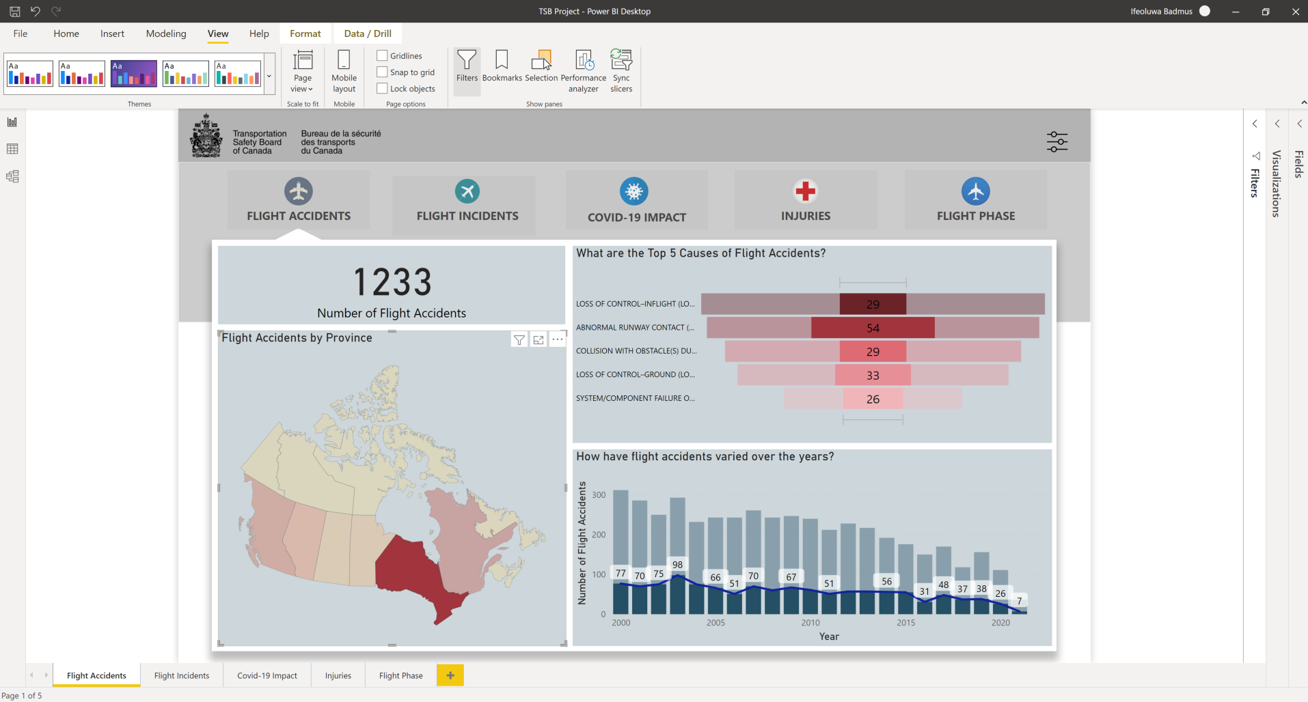
Solution
Reports
Notes:
A drill down with Ontario for accidents from year 2000 till date and the trends.

Slide 12
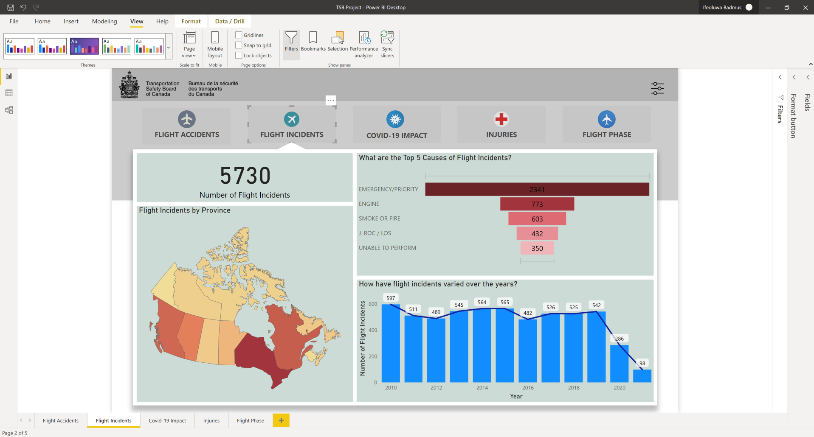
Solution
Reports
Notes:
A flight incident report page showing Total number of Flight incidents in Canada since 2010, top causes, trend over the years and a heat map of the incidents by province

Slide 13
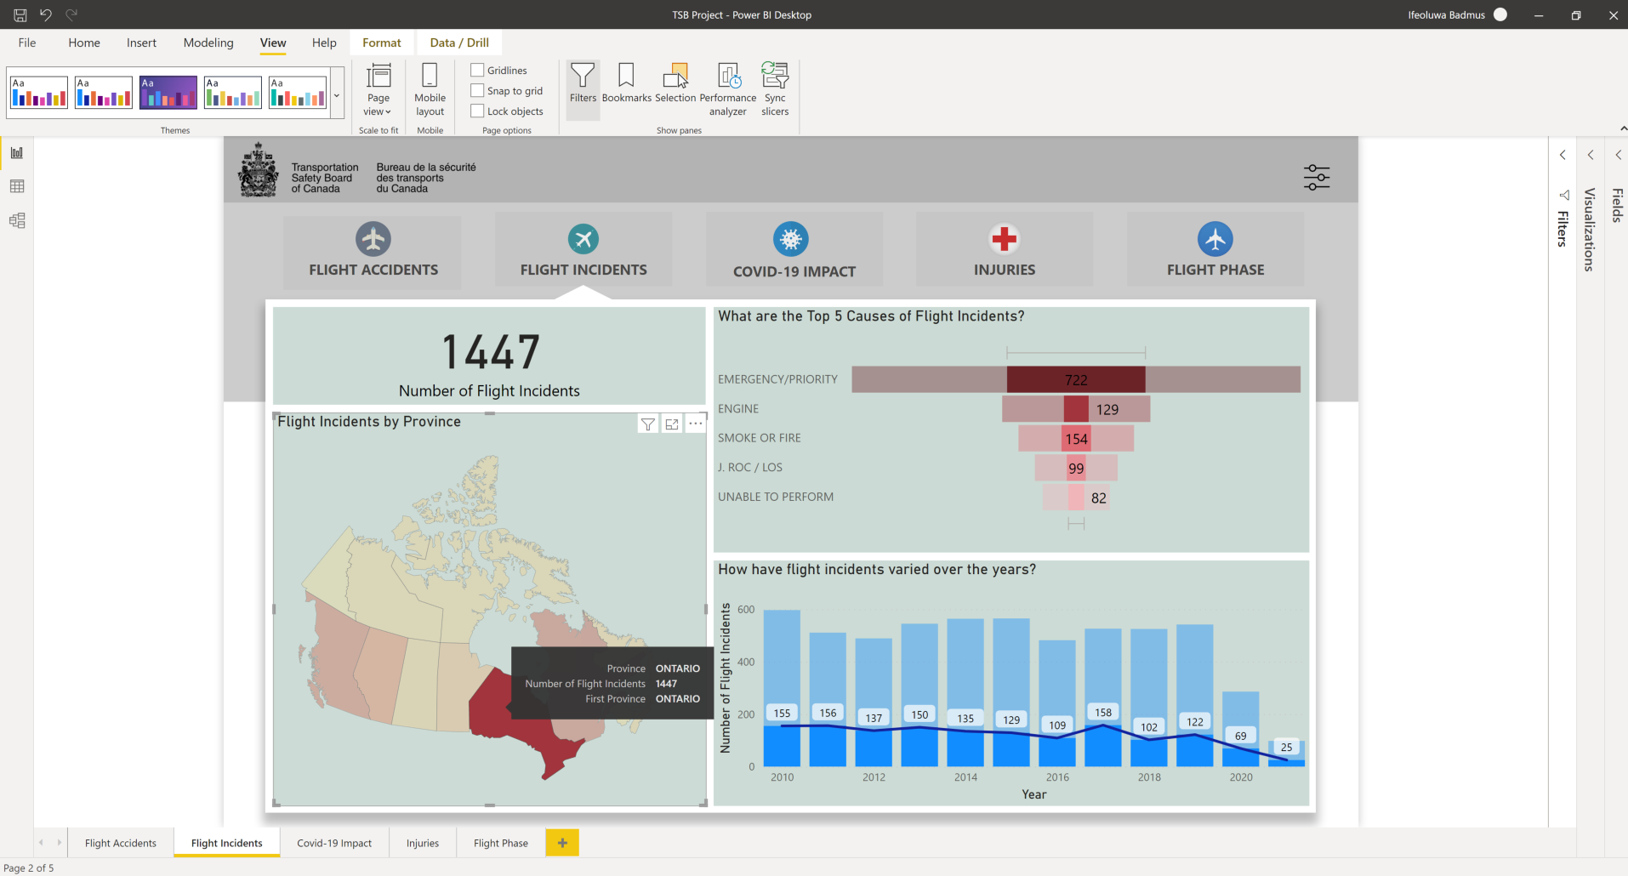
Solution
Reports
Notes:
A drill down by Ontario

Slide 14
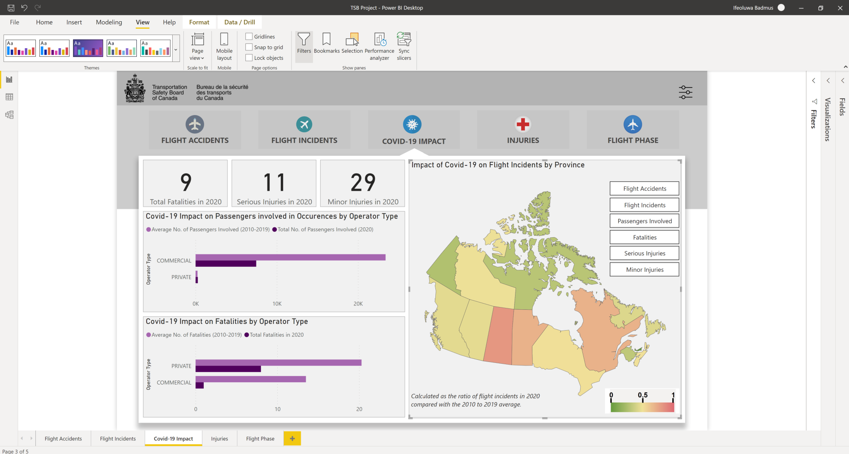
Solution
Reports
Notes:
A covid-19 impact report Page along with a heat map showing ratio of flight incidents in 2020 compared with the 2010 to 2019 average

Slide 15
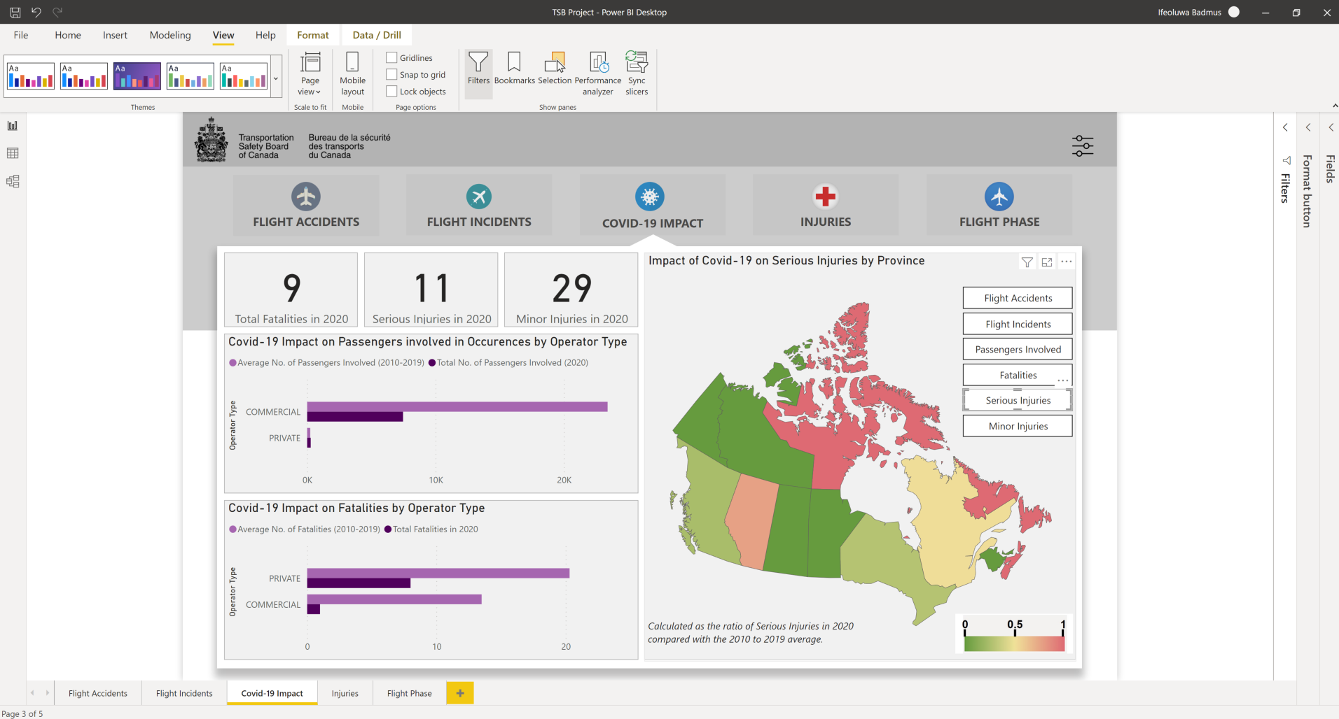
Solution
Reports
Notes:
Note the filter on the heat map was adjusted to show ratio of serious injuries

Slide 16
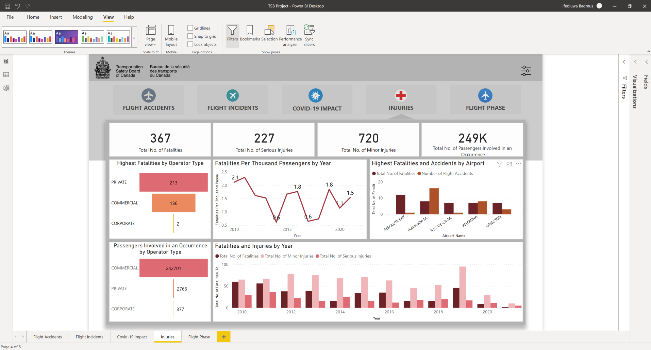
Solution
Reports
Notes:
An Injuries report page

Slide 17
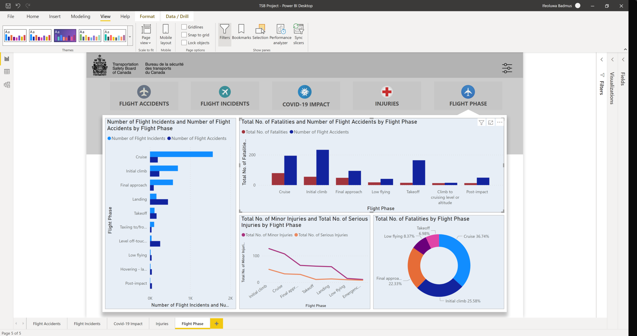
Solution
Reports
Notes:
A flight phase report page detailing how different phases contributes fatalities, injuries , incidents and accidents

Slide 18
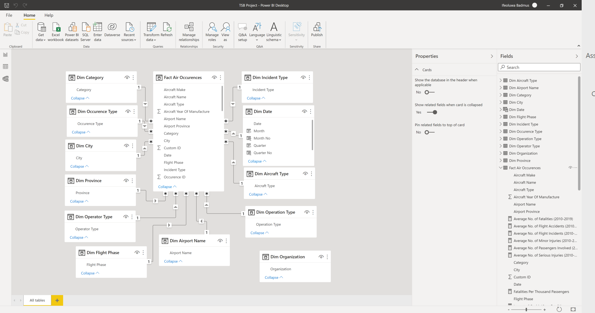
Solution
Data Model
Notes:
The data model showing the existing relationships between the dimension tables and the fact table and their respective cardinalities

